Slide 1
Interpreting for Naturalization Interview: Guide for volunteer interpreters

Slide 2
Introduction
Welcome and purpose of the session.​
Naturalization interviews: what they are and why interpreters matter.​
Volunteers play a key role in making the process accessible and fair.

Slide 3
Naturalization Process​ Requirements
Be 18 years old.​
Be a legal permanent resident for at least 5 years or 3 if married to a U.S. Citizen. ​
Must read, write, speak and understand English.​
Pass civics test 6/10 correct out of 100 possible

Slide 4
Requirement
Exceptions to English Requirement:
50 years old/20 years LPR
(No English/ 100 Q’s)
55 years old/15 years LPR
(No English/100 Q’s)
65 years old/20 years LPR
(No English/20 Q’s)
Medical Disability Exception

Slide 5
Requirement
Be a person of Good Moral Character
No serious criminal convictions
All taxes filed and paid.
No unpaid child/spouse support obligation
Selective Service Registration
18-26 ys old men
No long absences from the US

Slide 6
Requirement
Support the principles of the Constitution and the form of government of the US
Oath of Allegiance
(Juramento de lealtad)

Slide 7
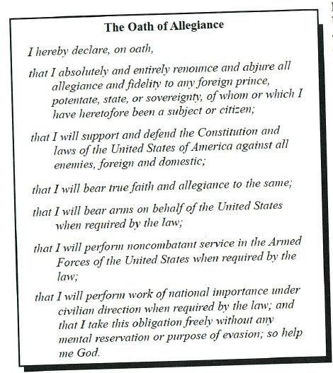

Slide 8
The Process
Complete Application
Send Application to USCIS
Receive Receipt letters from USCIS
May have a Biometric Appointment
May receive letter that USCIS will reuse digital fingerprints –picture that will be on certificate
Interview; English Test and Civics Test;
If English is exempt, the applicant must bring an interpreter 18 years or older.
Oath Ceremony

Slide 9
The Role of the Interpreter:
Interpretation- Conveying spoken messages from one language to another
Interpreter – Translate speech orally
Types of Interpretation:
Consecutive interpretation is the standard for USCIS interviews.
May occasionally use sight translation if reading documents.
No simultaneous interpretation needed here.

Slide 10
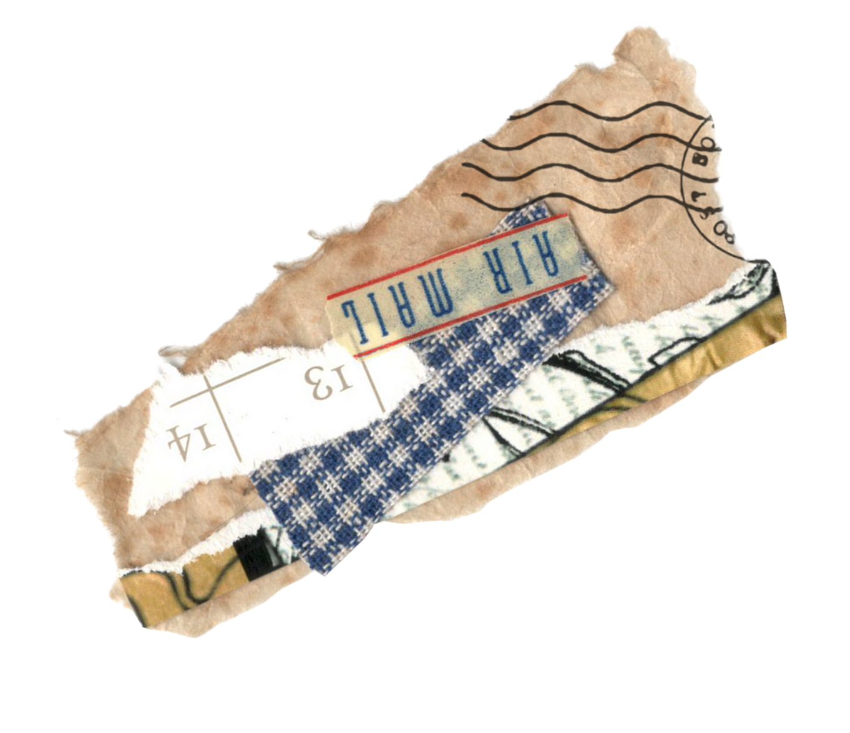
THE ROLE OF THE INTERPRETER:
Conduit: Your job is to transmit messages faithfully between the officer and the applicant.
Clarifier: If needed, you may ask for repetition or clarification to ensure accurate interpretation.
Cultural broker (rare in this setting): Only if misunderstandings arise from cultural differences—but usually not used in naturalization interviews.
NOT: a helper, advocate, or legal advisor.
Key Point: You’re there to support communication—not to help the applicant "pass" the interview.

Slide 11
CORE PRINCIPLES
Conduit: Your job is to transmit messages faithfully between the officer and the applicant.
Clarifier: If needed, you may ask for repetition or clarification to ensure accurate interpretation.
Cultural broker (rare in this setting): Only if misunderstandings arise from cultural differences—but usually not used in naturalization interviews.
NOT: a helper, advocate, or legal advisor.
Key Point: You’re there to support communication—not to help the applicant "pass" the interview.

Slide 12
INTERVIEW PROCESS
Explain the flow of interview.
What to expect- how to dress, etc.
Interpreter form from USCIS

Slide 13
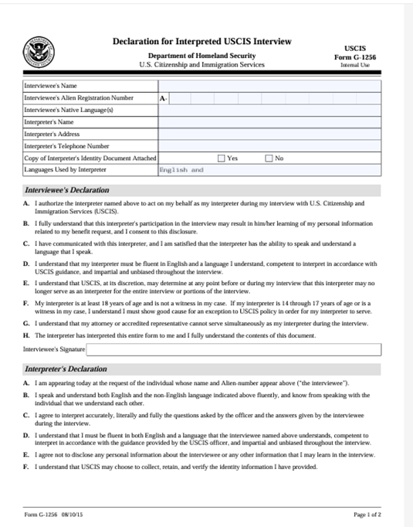
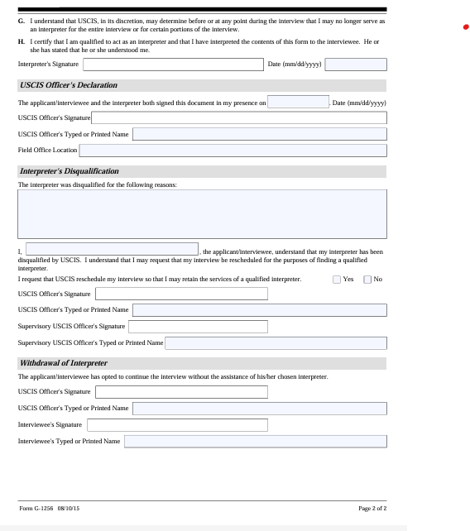
INTERVIEW PROCESS
Interpreter form from USCIS

Slide 14
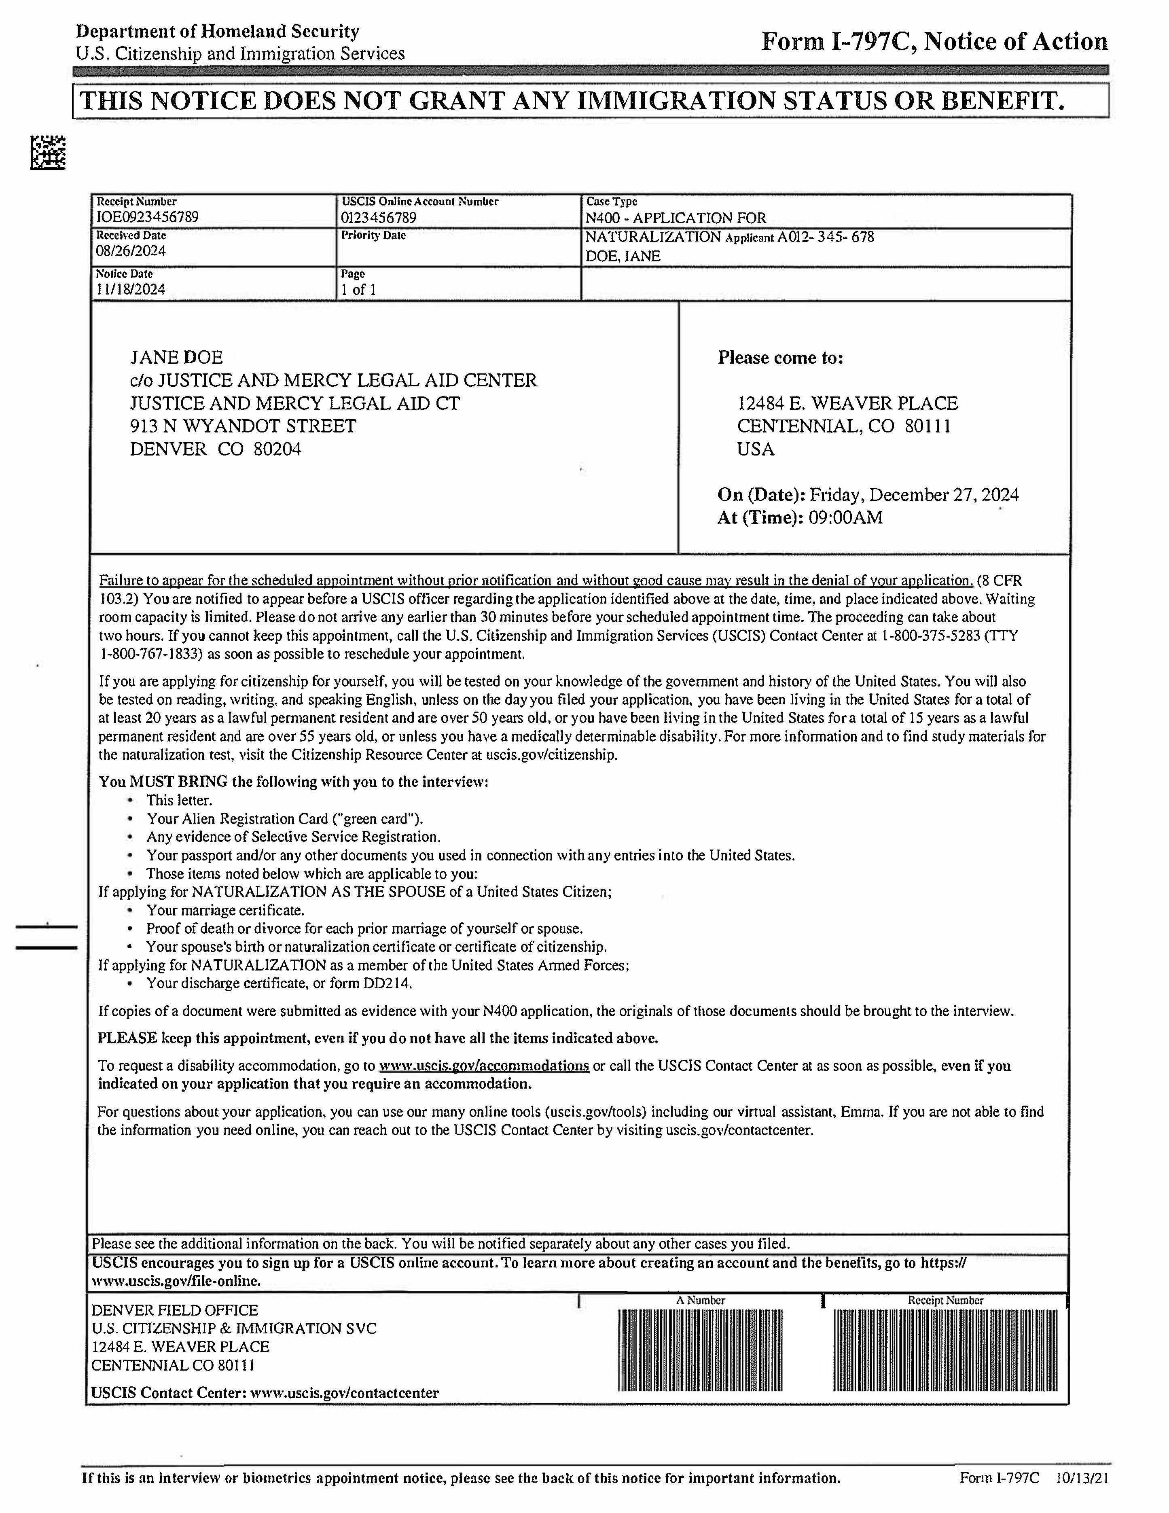
INTERVIEW NOTICE

Slide 15
ROLE pLAY
A short explanation before the interview begins to set expectations.
Say this to both parties (in English and then in the applicant’s language):
“Hello, my name is [Name]. I will be your interpreter today. I will interpret everything you say exactly as you say it. Please speak in short sentences and pause often. If I need a clarification, I will let you know.”
Helps establish professionalism and prepares everyone for the flow of communication.

Slide 16
DOS AND DON’TS
✅ Dos:
Interpret in first person (“I am here for my interview”).
Ask for clarification when needed.
Maintain a professional demeanor (calm and neutral tone).
Inform the officer if you’re struggling.
❌ Don’ts:
Don’t paraphrase or summarize.
Don’t answer questions on behalf of the applicant.
Don’t give advice or explain questions.
Don’t add or remove information

Slide 17
COMMON SCENARIO TIPS
If you miss a word: “Interpreter requests repetition.”
If the applicant speaks too long: Politely ask them to pause more frequently.
Emotional or high-pressure moments: Stay calm and focus on your role.

Slide 18
WRAP UP
Next steps- Sign up with Tana, sign agreement, certificates of attendance, etc.
Be aware of a follow-up email with the link to this training and additional materials related to it.
Available resources https://www.uscis.gov/sites/default/files/document/memos/2017-17-1-RoleUseInterpreters-PM-602-0125-1.pdf

Slide 19
913 N. Wyandot St. Denver, co 80204
(303) 839-1008
THANK YOU FOR VOLUNTEERING!

